Slide 1

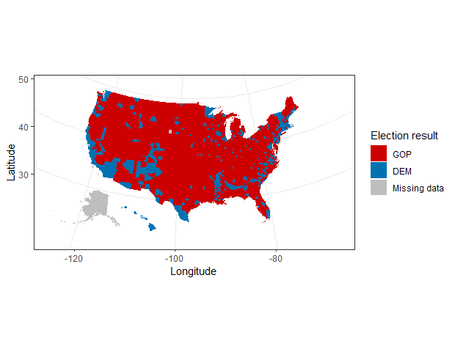
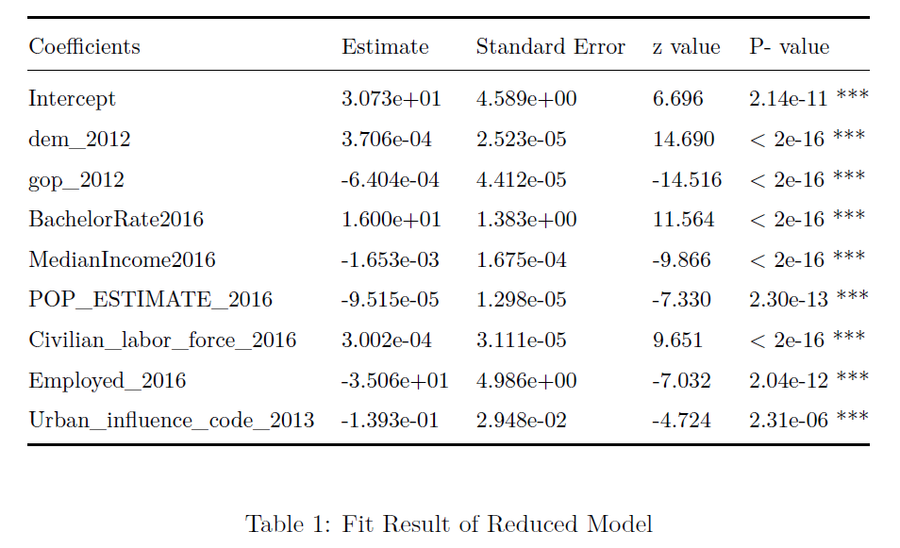
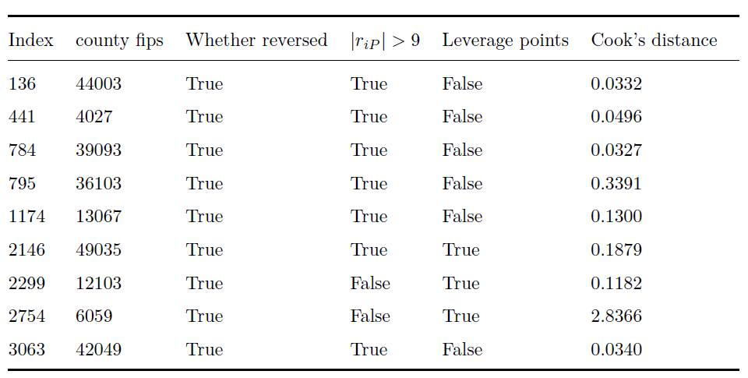
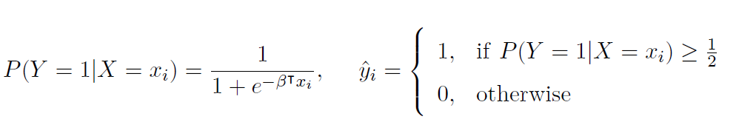

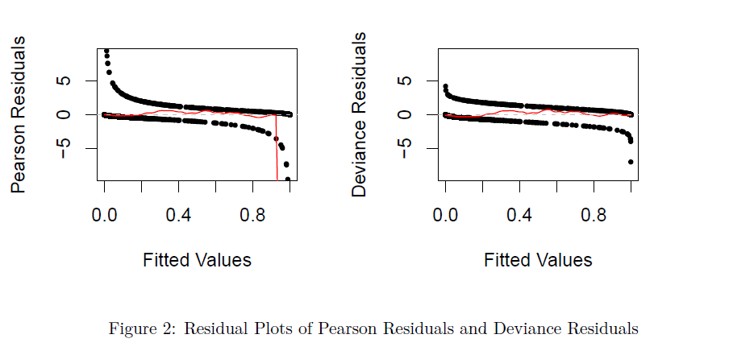
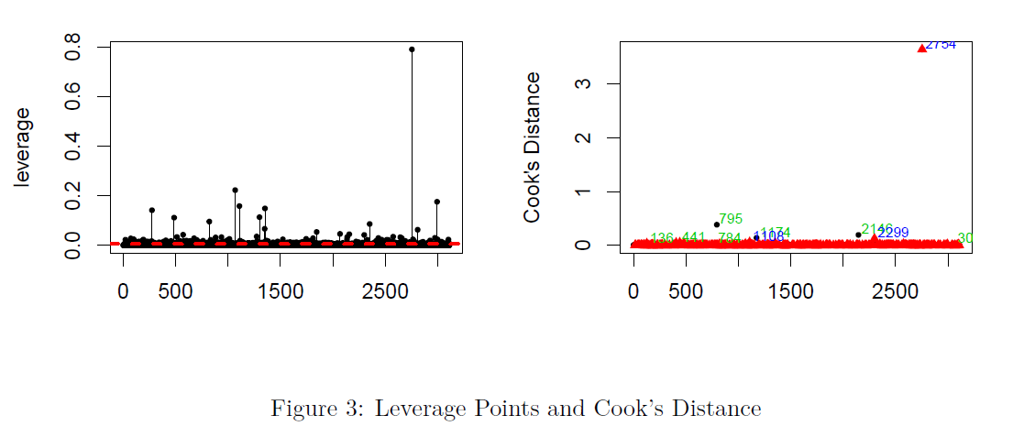
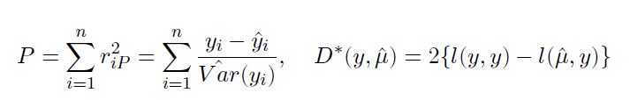

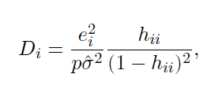
STA223 Project 1: Analysis of 2016 United States presidential election's result
Yunan Hou
Master's Student in Biostatistics
University of California at Davis
Introduction
United States presidential election's result is always very impactful and worthy to analyze. Here we want to know which demography and economic factors are significantly crucial to the 2016 election result and describe the common characteristic of the counties which won by the Democratic Party(DEM), or the Republican Party(GOP). Since our response variable, the election result is binary type (1 is DEM's win, 0 is GOP's win), we choose logistic regression to build a general linear regression model to achieve our goal.
The dataset is collected by Jia et al. [1]. It includes 3111 counties in the 48 contiguous United States (except Oglala Lakota County, South Dakota) and Hawaii and 24 variables of the election result, demography and economic factors in 2012 and 2016 (etc. unemployment rate, median income and population). Appendix Table 3 shows the bachelor rate, median income, population, civilian labor force, and the unemployment rate all have a high correlation with themselves in the different years. After the colinear check, we delete all the 2012's variables except for 2012's election result and use the rest of the predictors to build the first model.
Method
Results
Conclusion
Model Building
Since our y is a binary response variable, we need to use logistic regression with the binomial family to build a general linear regression model to achieve our goal.
The model can be formally written as
Model Selection
BIC attempt to resolve the model selection problem by introducing a penalty term for the number of parameters in the model, which formally is
Goodness-of-fit Analysis
Pearson and deviance criteria
Model Diagnostics
Leverage points and Cook’s Distance
.
As a result, the fitness of the final model is not too bad. However, the leverage test and Cook Distance found dozens of data points with great impact, of which 3 points significantly affected the model in two tests at the same time; at the same time, the fit residual of several points is very large, indicating that they are difficult to be explained by the model. The union of the two sets of points is 9 counties listed in the table below, it is interesting that all of them turn over to another party in 2016, from whom they chose in 2012.
However, after closely checking these data points, we cannot consider them to be outliers or points of numerical errors and delete them. Instead, this may be because our data set failed to include some important independent variables that can affect the results of elections, and could not accurately describe why some counties changed their supporting parties in 2016.
Therefore, it is difficult to say that our final model can be used to predict election results. In the future, we hope to include more potential influence factors.

